Slide 1
5th District Lay Memorial
Two Thousand & Twenty-Two

Slide 2
Memorial Committee
Prayer..... Scripture..... Spoken Word

Slide 3
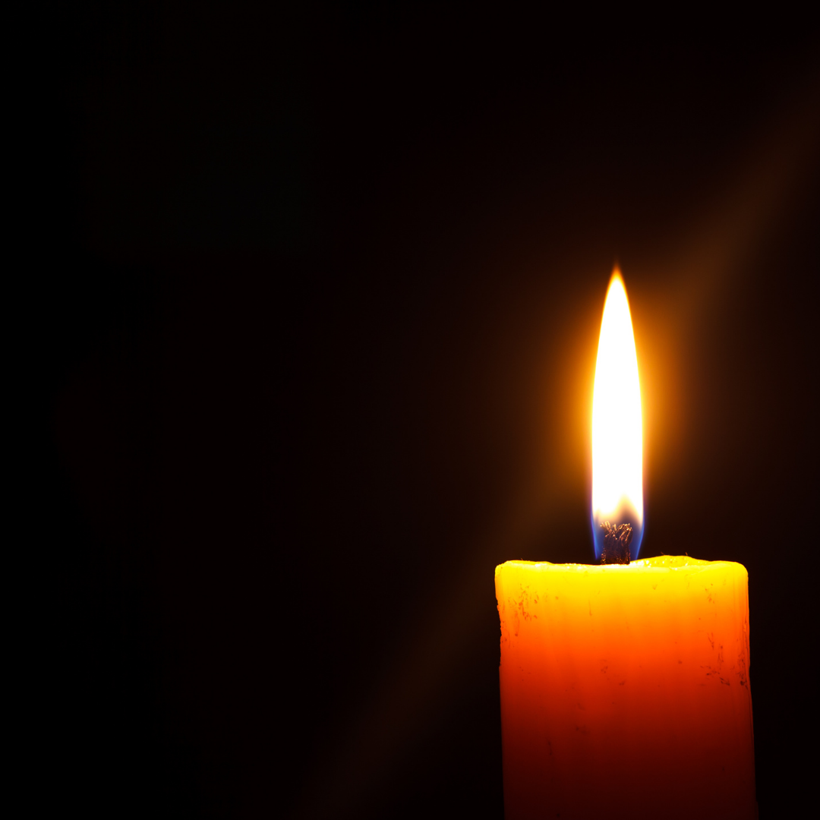
We Will Remember You
John 15:5-7 (NLT)

Slide 4
Southern California Conference
Alma Burch ~ Otis Foster, Sr. ~ Billy McIntyer ~ Janice Stephens ~ Bonnie Ruth Edwards ~ Oscar Cowan ~ Tom Rall ~ Mary Armistead ~ JUDGE PATRICIA MAYBERRY ~ Faye Edmond ~ Glenda June Kennedy ~ Mother Mae Collier ~ Henry Chambers

Slide 5
California Conference
Marietta Swann Lilyan Mitchell Kenneth Fields Bessie Toney
Frankie Jacobs Gillette
Alfred Patterson

Slide 6
Trouble Of The World

Slide 7
We Will Remember You
Romans 14:7-9 (NLT)

Slide 8
Midwest Conference
Kenneth Speese ~ Naomi Shaw ~ Stanley Counts, Jr. ~ Omaha Cahill ~ Artie Williams, Jr. ~ William Nelson ~ Lillian Tyler ~ Gregg Tabernacle ~ Lula Weathers ~ Cheryl Mitchell ~ Katie Howlett ~ Irene Carter

Slide 9
Missouri Conference
Estler Herron ~ Catherine Wysinger ~ Samantha Kendall ~ Margie McKinney ~ Calvin Mitchell ~ Deaconess Frances Otilla Stith Washington ~ Lana Mitchell ~ George DeMyers ~ Judith Anthony

Slide 10
His Eye Is On The Sparrow

Slide 11
We Will Remember You
1 Corinthians 15:21-25 (NLT)

Slide 12
Desert Mountain Conference
Rena Paris-Bendaw
DEBORAH COX

Slide 13
Pacific Northwest Conference
Gilda Oliver

Slide 14
I Look To You

Slide 15
To God Be The Glory
Those we love must someday pass beyond our present sight…
Must leave us and the world we know without their radiant light.
But we know that like a candle their lovely light will surely shine to brighten up another place more perfect… more divine. And in the realm of Heaven where they shine so warm and bright.
Our loved ones live forevermore in God’s eternal light

